Slide 1
Prediction and Uncertainty

Slide 2
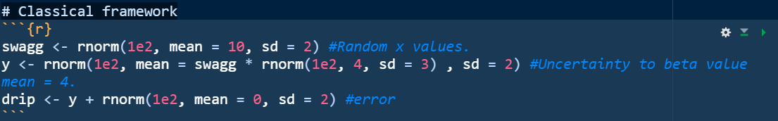
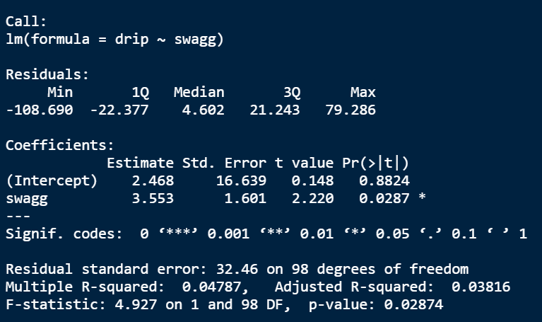
Classical
Classical (frequentist framework):
Hypothesis testing & significance value.
“If H₀ is true, then we would expect to get a result as extreme as the one obtained from our sample 2.9% of the time. Since that p-value is smaller than our alpha level of 5%, we reject the null hypothesis in favor of the alternate hypothesis.”
frequentist interpretation that views probability as the limit of the relative frequency of an event after many trials.

Slide 3
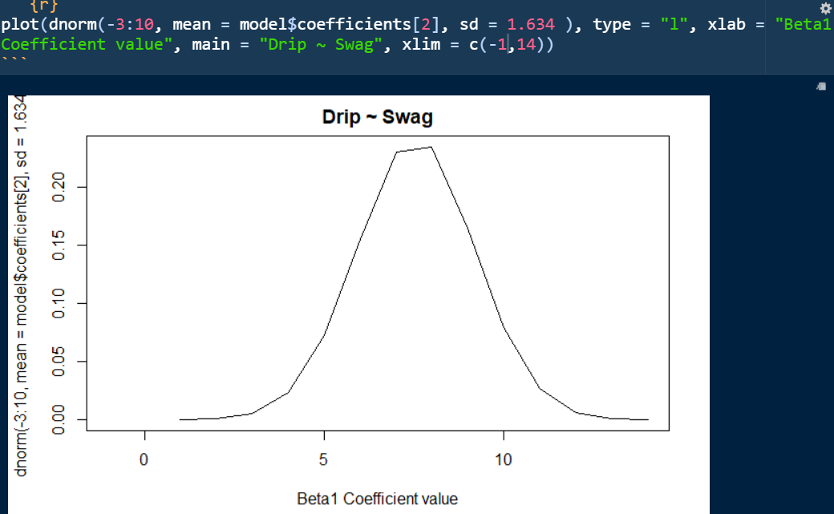
Classical
Don’t just look at the p-value (*).
Our swag estimate of 3.553 has uncertainty surrounding it. (Standard Error)
Looking at the distribution of our possible beta values is much more informative.
While not exclusive to Bayesian statistics this approach is more prevalent in bayes.
Get used to this visualization instead of tables.

Slide 4
Probabilities
Bayesian statistics deals a lot with probabilities.
We won’t got deep into it but appreciate this for a minute.
The paradox of the shark bite.
P(‘dying within two years’|’head bitten off by shark’) = 1
P(’head bitten off by shark’| ‘dying within two years’) = .0001
Inverting conditional probabilities makes a huge difference.
Classical Framework :
P(“How many died from shark bites (D)”| “ People die from shark bites (H)”)
we can’t say anything directly about the hypothesis but how well the data conform to the hypothesis.

Slide 5
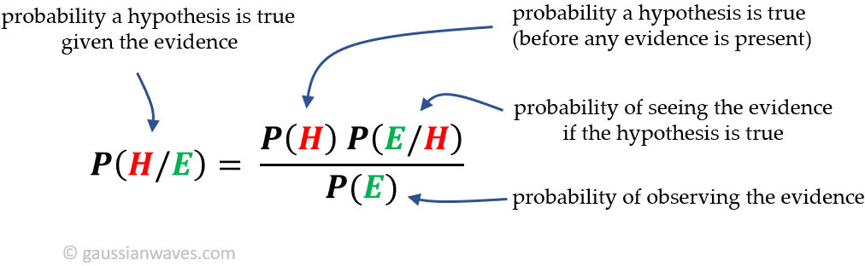
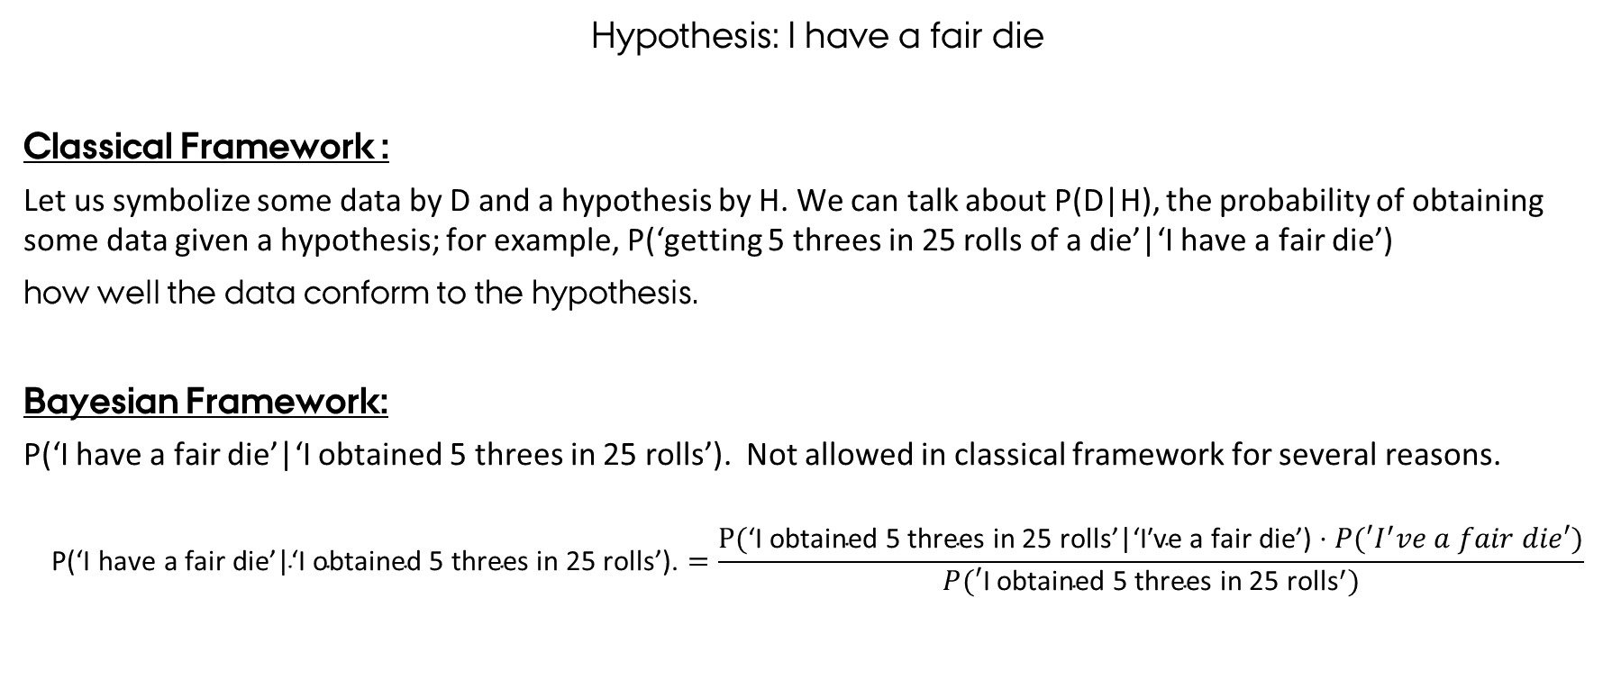
Probabilities Dice
Hypothesis: I have a fair die
Classical Framework :
Let us symbolize some data by D and a hypothesis by H. We can talk about P(D|H), the probability of obtaining some data given a hypothesis; for example, P(‘getting 5 threes in 25 rolls of a die’|‘I have a fair die’)
how well the data conform to the hypothesis.
Bayesian Framework:
P(‘I have a fair die’|‘I obtained 5 threes in 25 rolls’). Not allowed in classical framework for several reasons.
$$\text{P}\text{(}\text{‘}\text{I} \text{have} \text{a} \text{fair} \text{die}\text{’}\text{|}\text{‘}\text{I} \text{obtained}\text{ 5 }\text{threes} \text{in}\text{ 25 }\text{rolls}\text{’}\text{).}=\frac{\text{P}\text{(}\text{‘}\text{I} \text{obtained}\text{ 5 }\text{threes} \text{in}\text{ 25 }\text{rolls}\text{’}\text{|}\text{‘}\text{I}\text{′}\text{ve} \text{a} \text{fair} \text{die}\text{’}\text{)}⋅P(′I^{′}ve a fair die′)}{P(′\text{I} \text{obtained}\text{ 5 }\text{threes} \text{in}\text{ 25 }{\text{rolls}}^{′})}$$

Slide 6
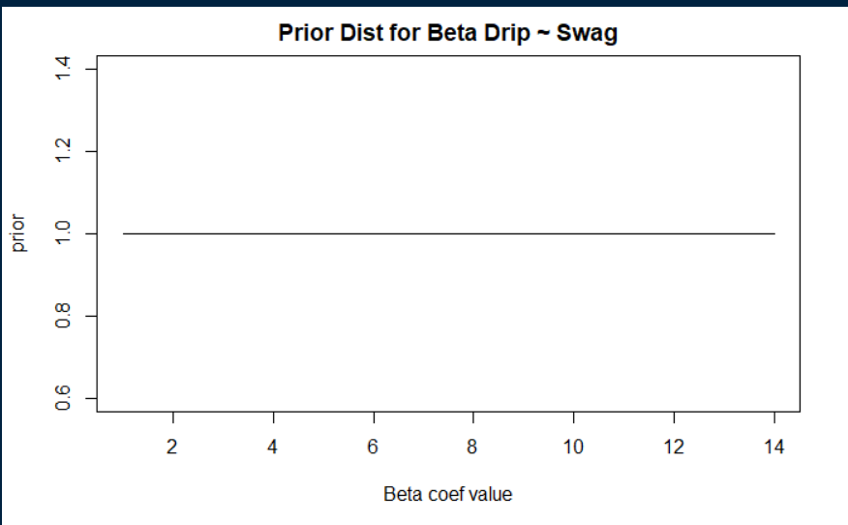
Bayesian prior and posterior:
Bayesian inference involves three steps that go beyond classical estimation.
we can include additional information into the model using a prior distribution.
The data and model are combined to form a posterior distribution. (Combining our data and prior)

Slide 7
Bayesian:
Bayesian inference involves three steps that go beyond classical estimation.
we can include additional information into the model using a prior distribution.
The data and model are combined to form a posterior distribution.
we can propagate uncertainty in this distribution—that is, we can get simulation-based predictions for unobserved or future outcomes that accounts for uncertainty in the model parameters.
We can do this with probability distributions as those seen on the slide before.

Slide 8
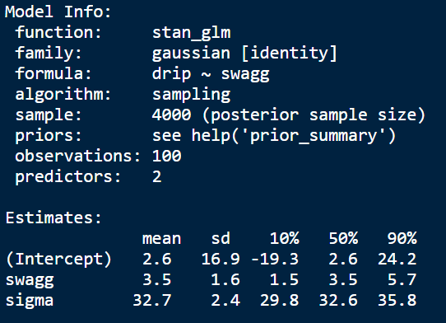
Stan_glm()
The function for Bayesian:
Output:
Generalized model with identity link.
It uses sampling.
We’ve 4000 samples.
Posterior mean and their SD
Residual standard deviation. What is the spread of the residuals?

Slide 9
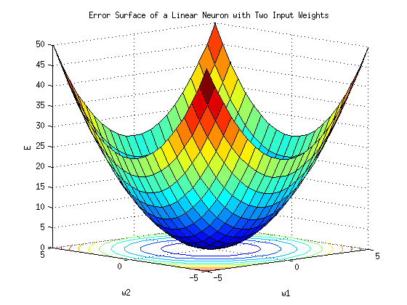
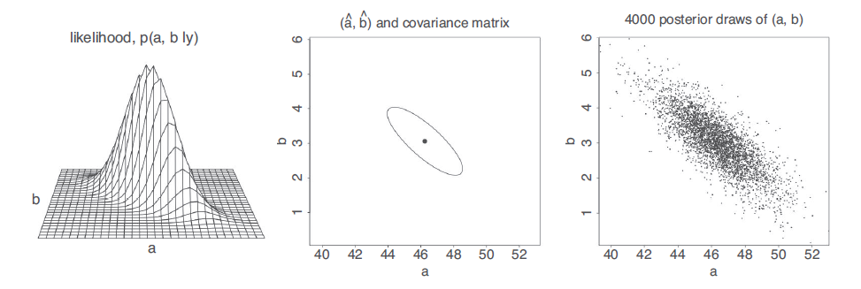
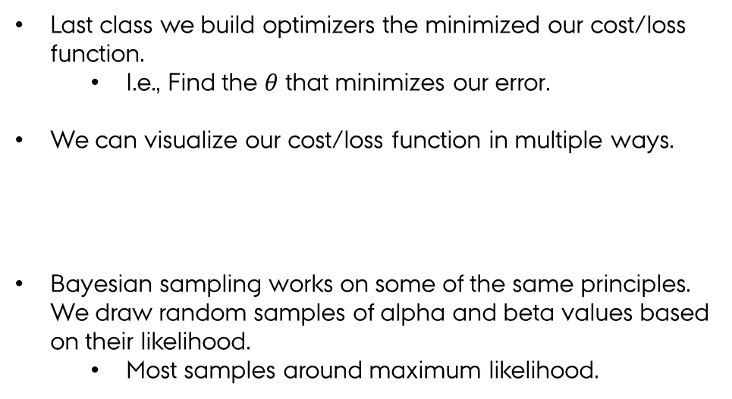
What does the sampling mean?
Last class we build optimizers the minimized our cost/loss function.
I.e., Find the $θ$ that minimizes our error.
We can visualize our cost/loss function in multiple ways.
Bayesian sampling works on some of the same principles. We draw random samples of alpha and beta values based on their likelihood.
Most samples around maximum likelihood.

Slide 10
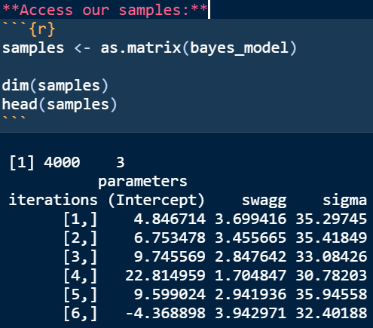
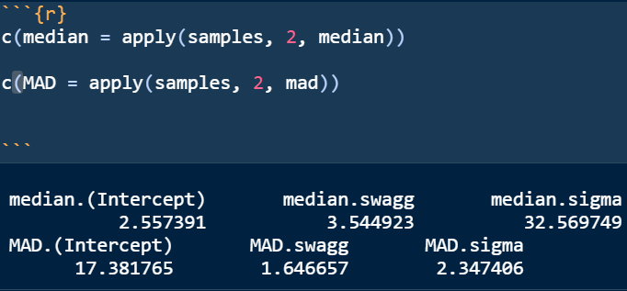
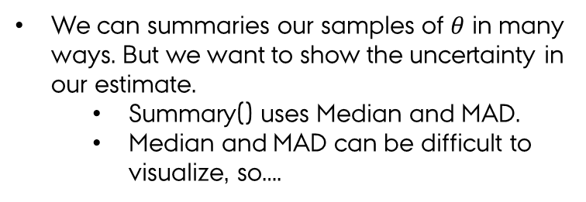
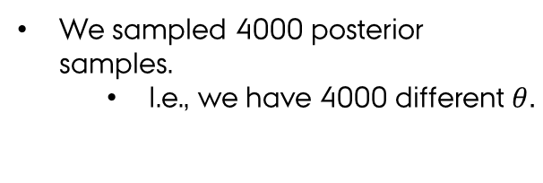
Sampling
We sampled 4000 posterior samples.
I.e., we have 4000 different $θ.$
We can summaries our samples of $θ$ in many ways. But we want to show the uncertainty in our estimate.
Summary() uses Median and MAD.
Median and MAD can be difficult to visualize, so….

Slide 11
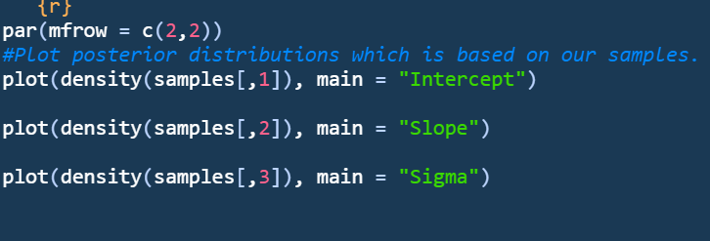
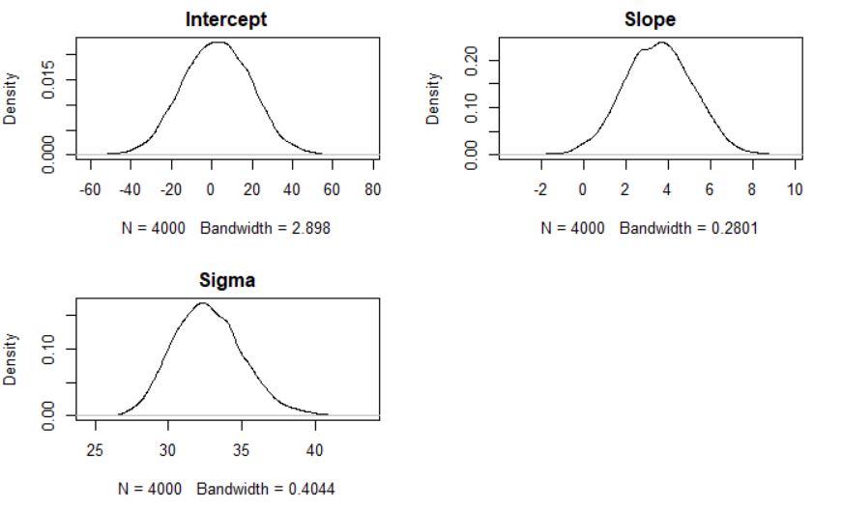
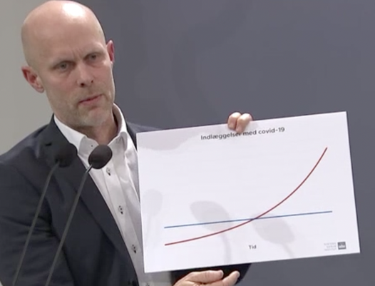
Plot our posterior
Plotting the posterior distribution which has the same median, mean and SD and MAD as the summary shows.
Visualizations are easier to interpret.
Top scientists always plot.

Slide 12
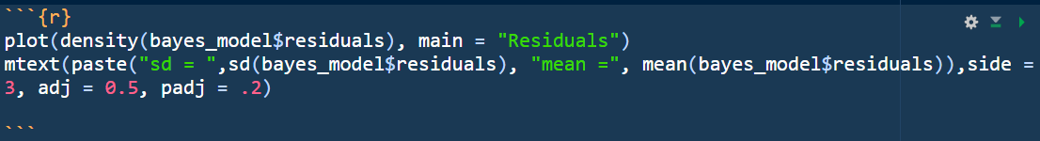
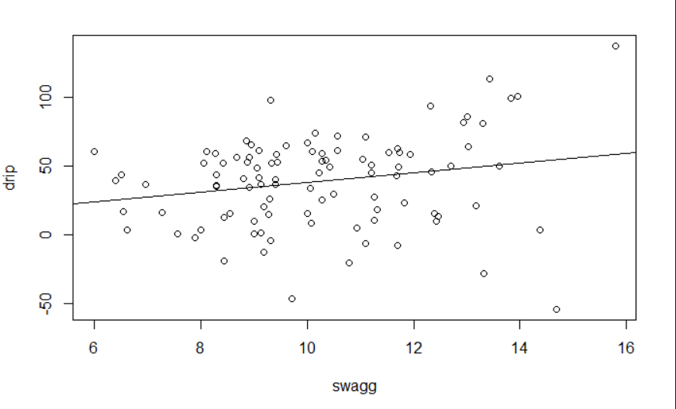
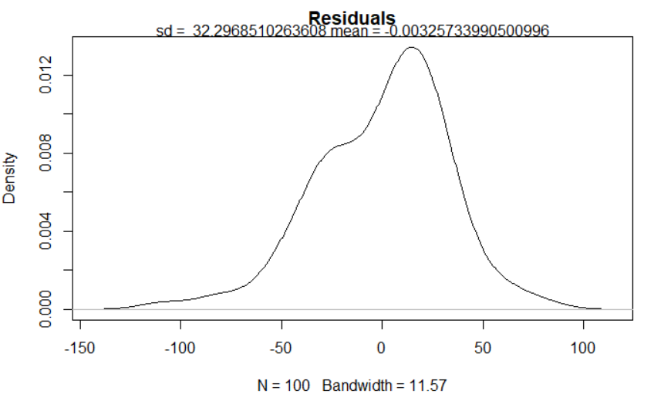
Sigma / Residual STD
Our sigma seemed rather large to let’s investigate.
Sigma is the SD of our error distribution surrounding 0.

Slide 13
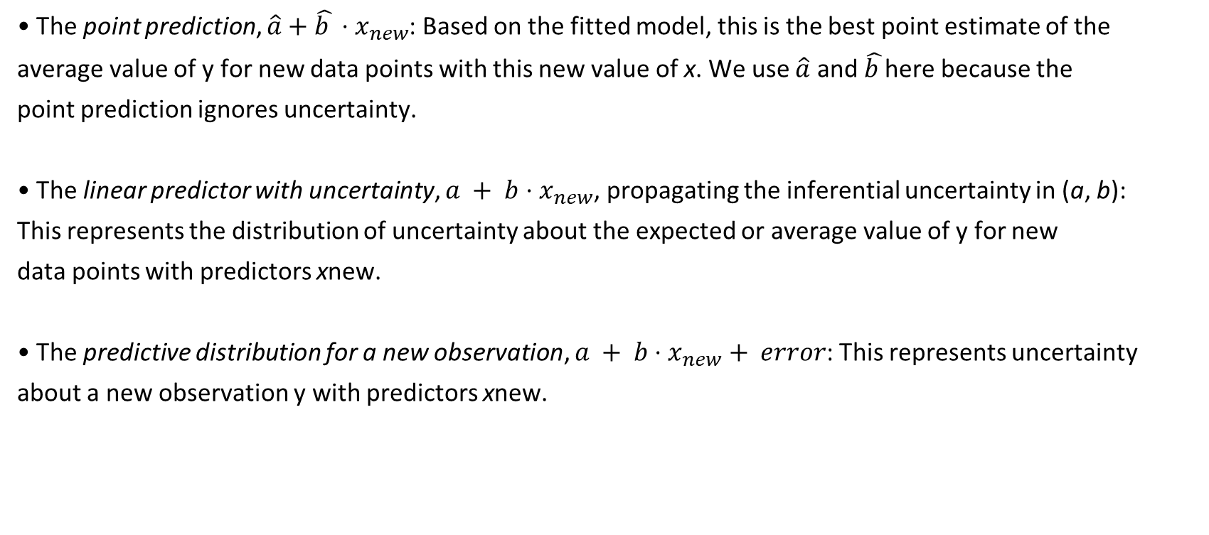
Prediction & Uncertainty.
• The point prediction, $\hat{a}+\hat{b }⋅x_{new}$: Based on the fitted model, this is the best point estimate of the
average value of y for new data points with this new value of x. We use $\hat{a}$ and $\hat{b }$here because the
point prediction ignores uncertainty.
• The linear predictor with uncertainty, $a + b{⋅x}_{new}$, propagating the inferential uncertainty in (a, b):
This represents the distribution of uncertainty about the expected or average value of y for new
data points with predictors xnew.
• The predictive distribution for a new observation, $a + b⋅x_{new}+ error$: This represents uncertainty
about a new observation y with predictors xnew.

Slide 14
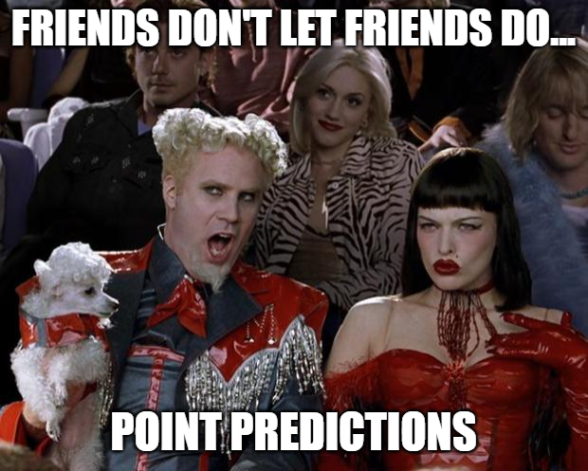
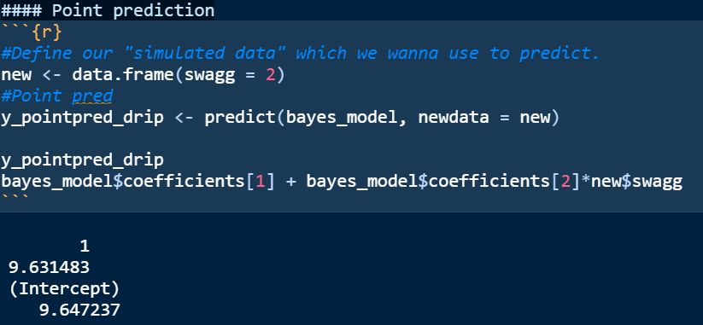
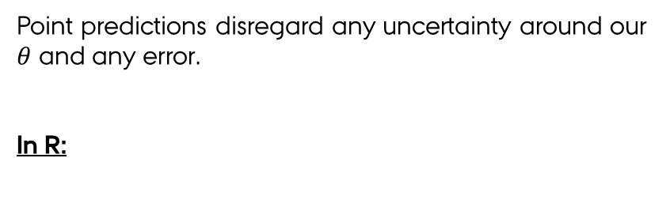
Point prediction
Point predictions disregard any uncertainty around our $θ$ and any error.
In R:

Slide 15
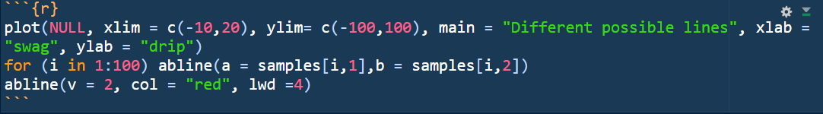
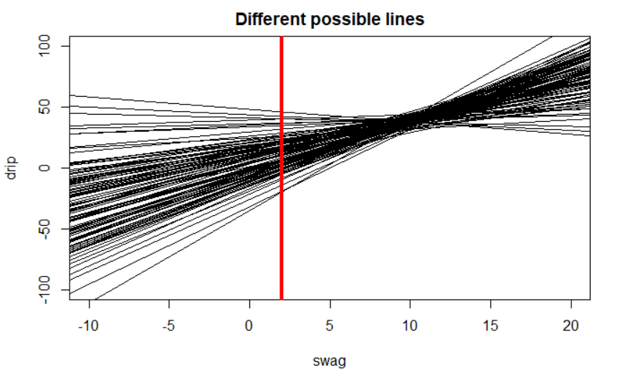
Linear prediction
Linear prediction takes the uncertainty about our coefficients into account.

Slide 16
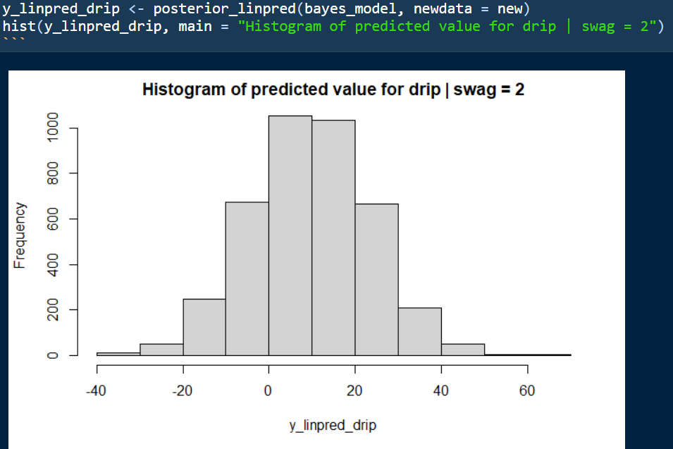
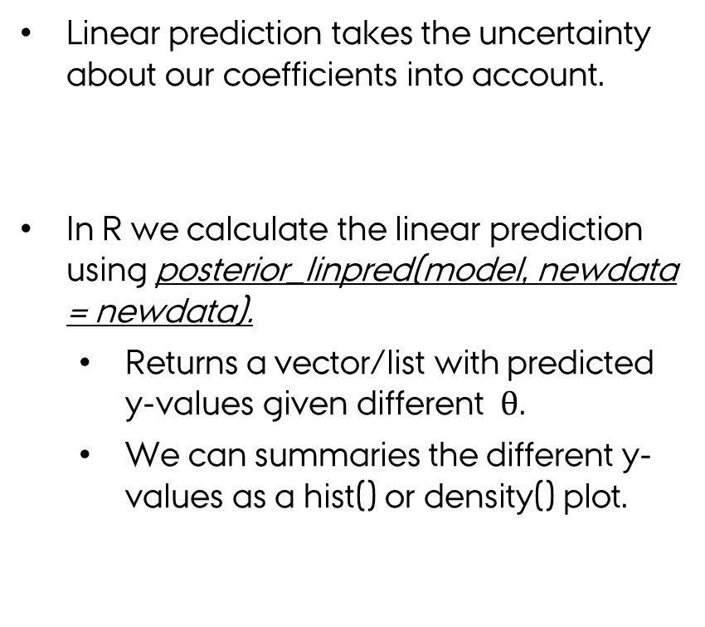
Linear prediction
Linear prediction takes the uncertainty about our coefficients into account.
In R we calculate the linear prediction using posterior_linpred(model, newdata = newdata).
Returns a vector/list with predicted y-values given different $θ$.
We can summaries the different y-values as a hist() or density() plot.

Slide 17
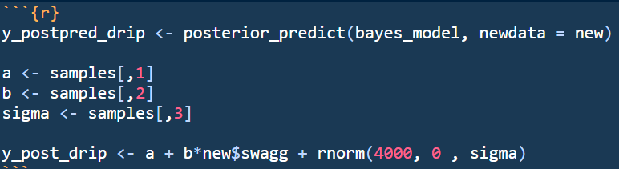
Predictive distribution
However, we know that our observed data points isn’t straight on the predicted line. Our data points are scattered around the line with some error.
We can quantify that error using our sigma which denoted the residual standard deviation for our residuals.
High sigma = large spread around the linear prediction line.
Low sigma = low spread around the linear prediction line.
In R:

Slide 18
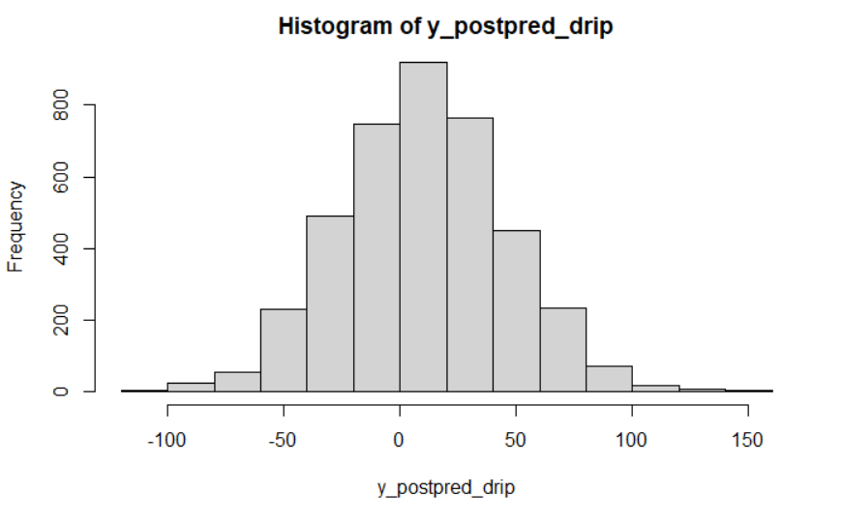
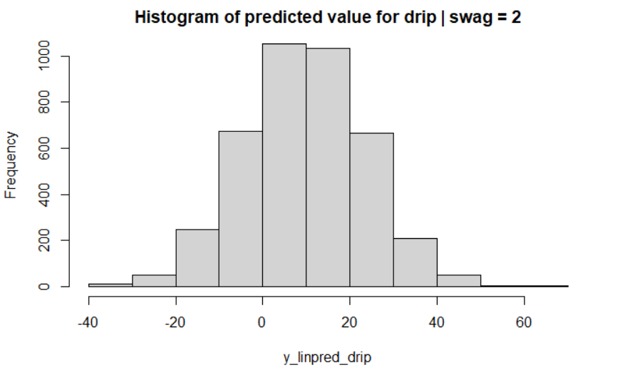
Posterior Predicton
LINEAR PREDICTION
Larger spread in posterior prediction than linear prediction?
Why??

Slide 19
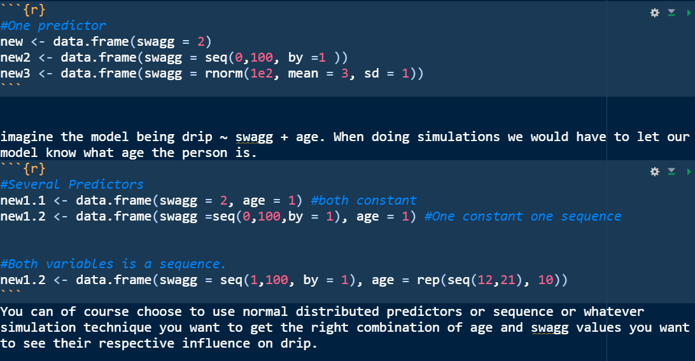
Sequence of values

Slide 20
Exercises:
9.2 (hint: check slides)
9.3 (Hint: check 9.1 and 9.2 in the chapter)
9.8
10.1
10.2
10.3 & 10.4
EXTRA Bayesian prior/posterior exercises; 9.5, 9.9 & 9.10

